Slide 1
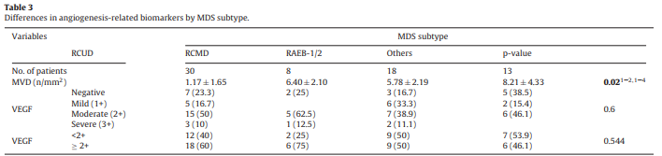
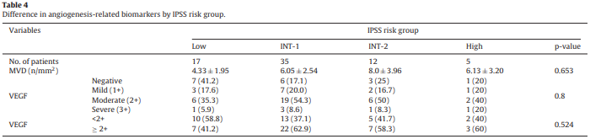
Biomarkers of angiogenesis as prognostic factors in myelodysplastic syndrome patients treated with hypomethylating agents
MVD of RCUD was significantly lower than in others such as RCMD and RAEB-1/2.
There was no significant differences in VEGF expression according to the subtype of MDS.
MVD expression did not differ among the risk groups based on the IPSS.
The low risk group tended to have lower expression of MVD and VEGF.
Leuk Res. 2016 Nov;50:21-28.

Slide 2
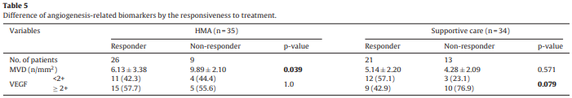
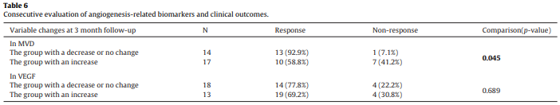
Biomarkers of angiogenesis as prognostic factors in myelodysplastic syndrome patients treated with hypomethylating agents
In the HMA group, the mean MVD in the responder group was significantly lower than that of the non-responder group (P = 0.039).
In the supportive care group, the mean MVD for responders was similar to that of 13 non-responders. The strong VEGF expression in non-responders tended to be more frequent than in responders (P = 0.079).
The group with a decrease or no change of MVD had a higher response rate compared to that in the group with an increase of MVD (P = 0.045).
Leuk Res. 2016 Nov;50:21-28.

Slide 3
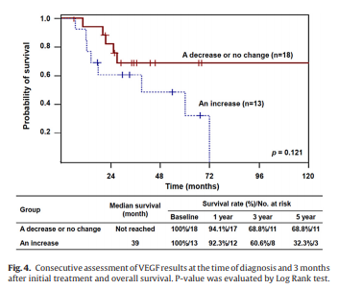
Biomarkers of angiogenesis as prognostic factors in myelodysplastic syndrome patients treated with hypomethylating agents
Although the changes of angiogenesis-related biomarkers were not associated survival outcomes, the group with a decrease or no change of VEGF had a trend to have a better survival outcome.
Leuk Res. 2016 Nov;50:21-28.

Slide 4
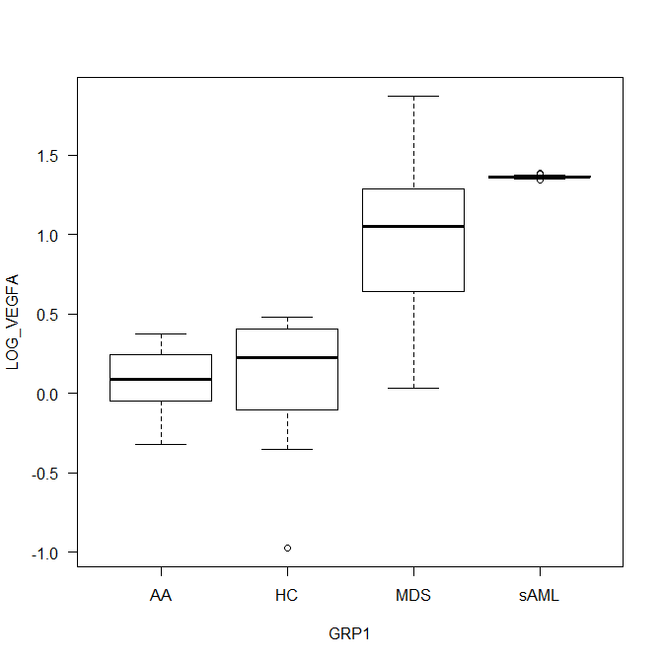
Log₁₀^{VEGFA} by C, MDS, sAML
AA – 0.09 (-0.32-0.38), HC – 0.23 (-0.98-0.48), MDS – 1.05 (0.03-1.88), sAML – 1.36 (1.34-1.39)
AA vs MDS (P < 0.01), AA vs sAML (P < 0.01), HC vs MDS (P < 0.01), HC vs sAML (P < 0.01), MDS vs SAML (P < 0.01)
N = AA 8, HC 18, MDS 84, sAML 17

Slide 5
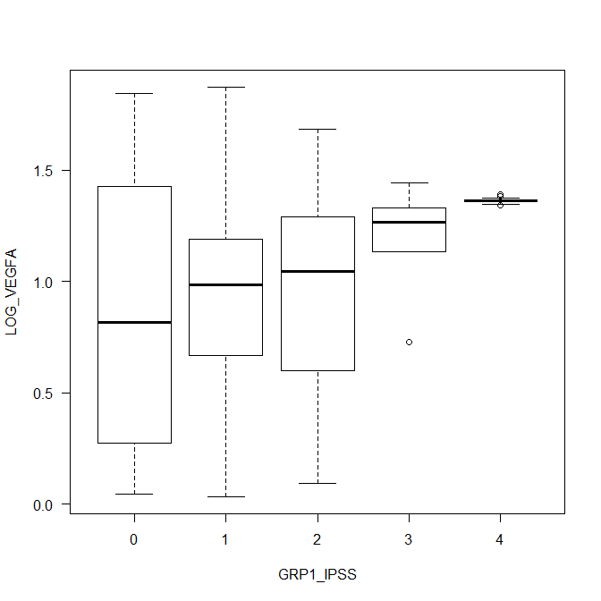
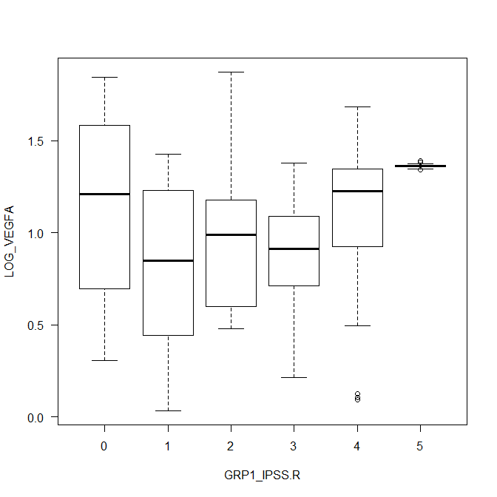
Log₁₀^{VEGFA} by IPSS
Log₁₀^{VEGFA} by IPSS-R
Low – 0.82 (0.04-1.84), Int-1 – 0.99 (0.03-1.88), Int-2 – 1.04 (0.09-1.69), High – 1.27 (0.73-1.44), sAML – 1.36 (1.34-1.39) (P < 0.01)
Low vs Int-2 (P = 0.04), Low vs sAML (P < 0.01), Int-2 vs sAML (P < 0.01), High vs sAML (P < 0.01)
N = Low 6, Int-1 43, Int-2 29, High 6, sAML 17
Very low – 1.21 (0.30-1.84), Low – 0.85 (0.03-1.43), Int – 0.99 (0.48-1.88), High – 0.91 (0.21-1.38), Very high – 1.23 (0.09-1.69), sAML – 1.36 (1.34-1.39) (P < 0.01)
Very low vs sAML (P < 0.01), Low vs sAML (P < 0.01), High vs sAML (P < 0.01), Very high vs sAML (P < 0.01)
N = Very low 4, Low 16, Int 20, High 20, Very high 24, sAML 17

Slide 6
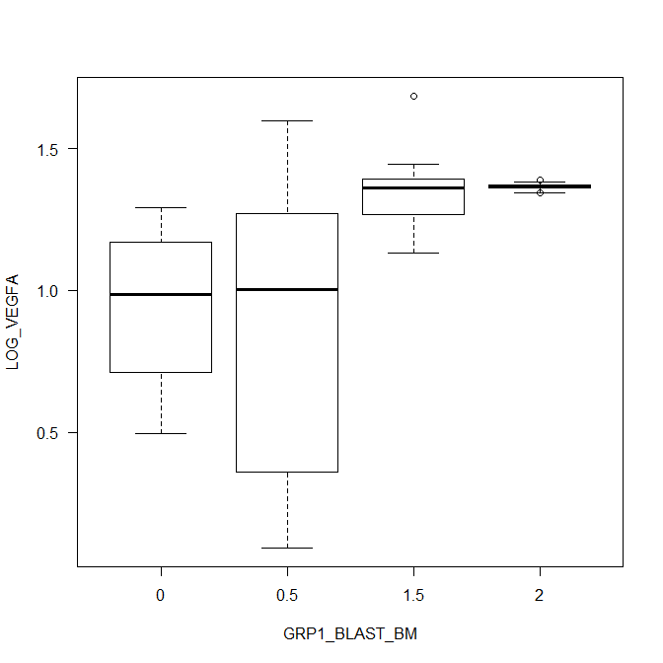
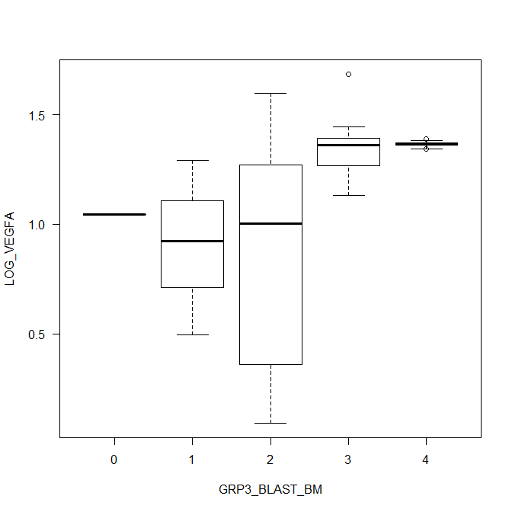
Log₁₀^{VEGFA} by BM blast G1
Log₁₀^{VEGFA} by BM blast G2
<5 – 0.93 (0.03-1.84), 5~10 – 1.02 (0.09-1.88), 11~20 – 1.33 (0.73-1.69), >20 – 1.36 (1.37-1.39) (P < 0.01)
<5 vs 11~20 (P < 0.01), <5 vs >20 (P < 0.01), 5~10 vs 11~20 (P = 0.01), 5~10 vs >20 (P < 0.01)
≤2 – 1.05 (0.03-1.84), 2.1~4.9 – 0.84 (0.04-1.43), 5~10 – 1.02 (0.09-1.88), 10.1~20 – 1.33 (0.73-1.69), >20 – 1.36 (1.34)-1.39 (P = 0.01)
≤2 vs 10.1~20 (P < 0.01), ≤2 vs >20 (P <0.01), 2.1~4.9 vs 10.1~20 (P < 0.01), 2.1~4.9 vs >20 (P < 0.01), 5~10 vs 10.1~20 (P = 0.01), 5~10 vs > 20 (P < 0.01)

Slide 7
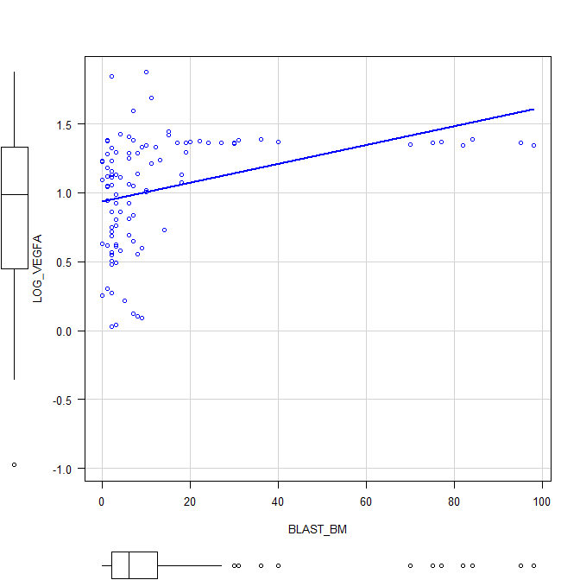
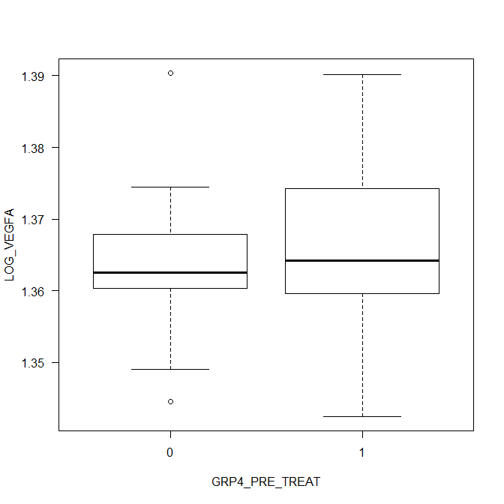
Log₁₀^{VEGFA} vs BM blast G1
Pre-treat vs No pre-treat
R² = 0.114
No pre-treat – 1.36(1.34-1.39), Pre-treat – 1.36(1.34-1.39) (P = 0.92)

